Slide 1

AutoGluon Multimodal
Fine-tunes foundation models with 3 lines of code!
Presenter: Dr. Shuai Zhang

Slide 2
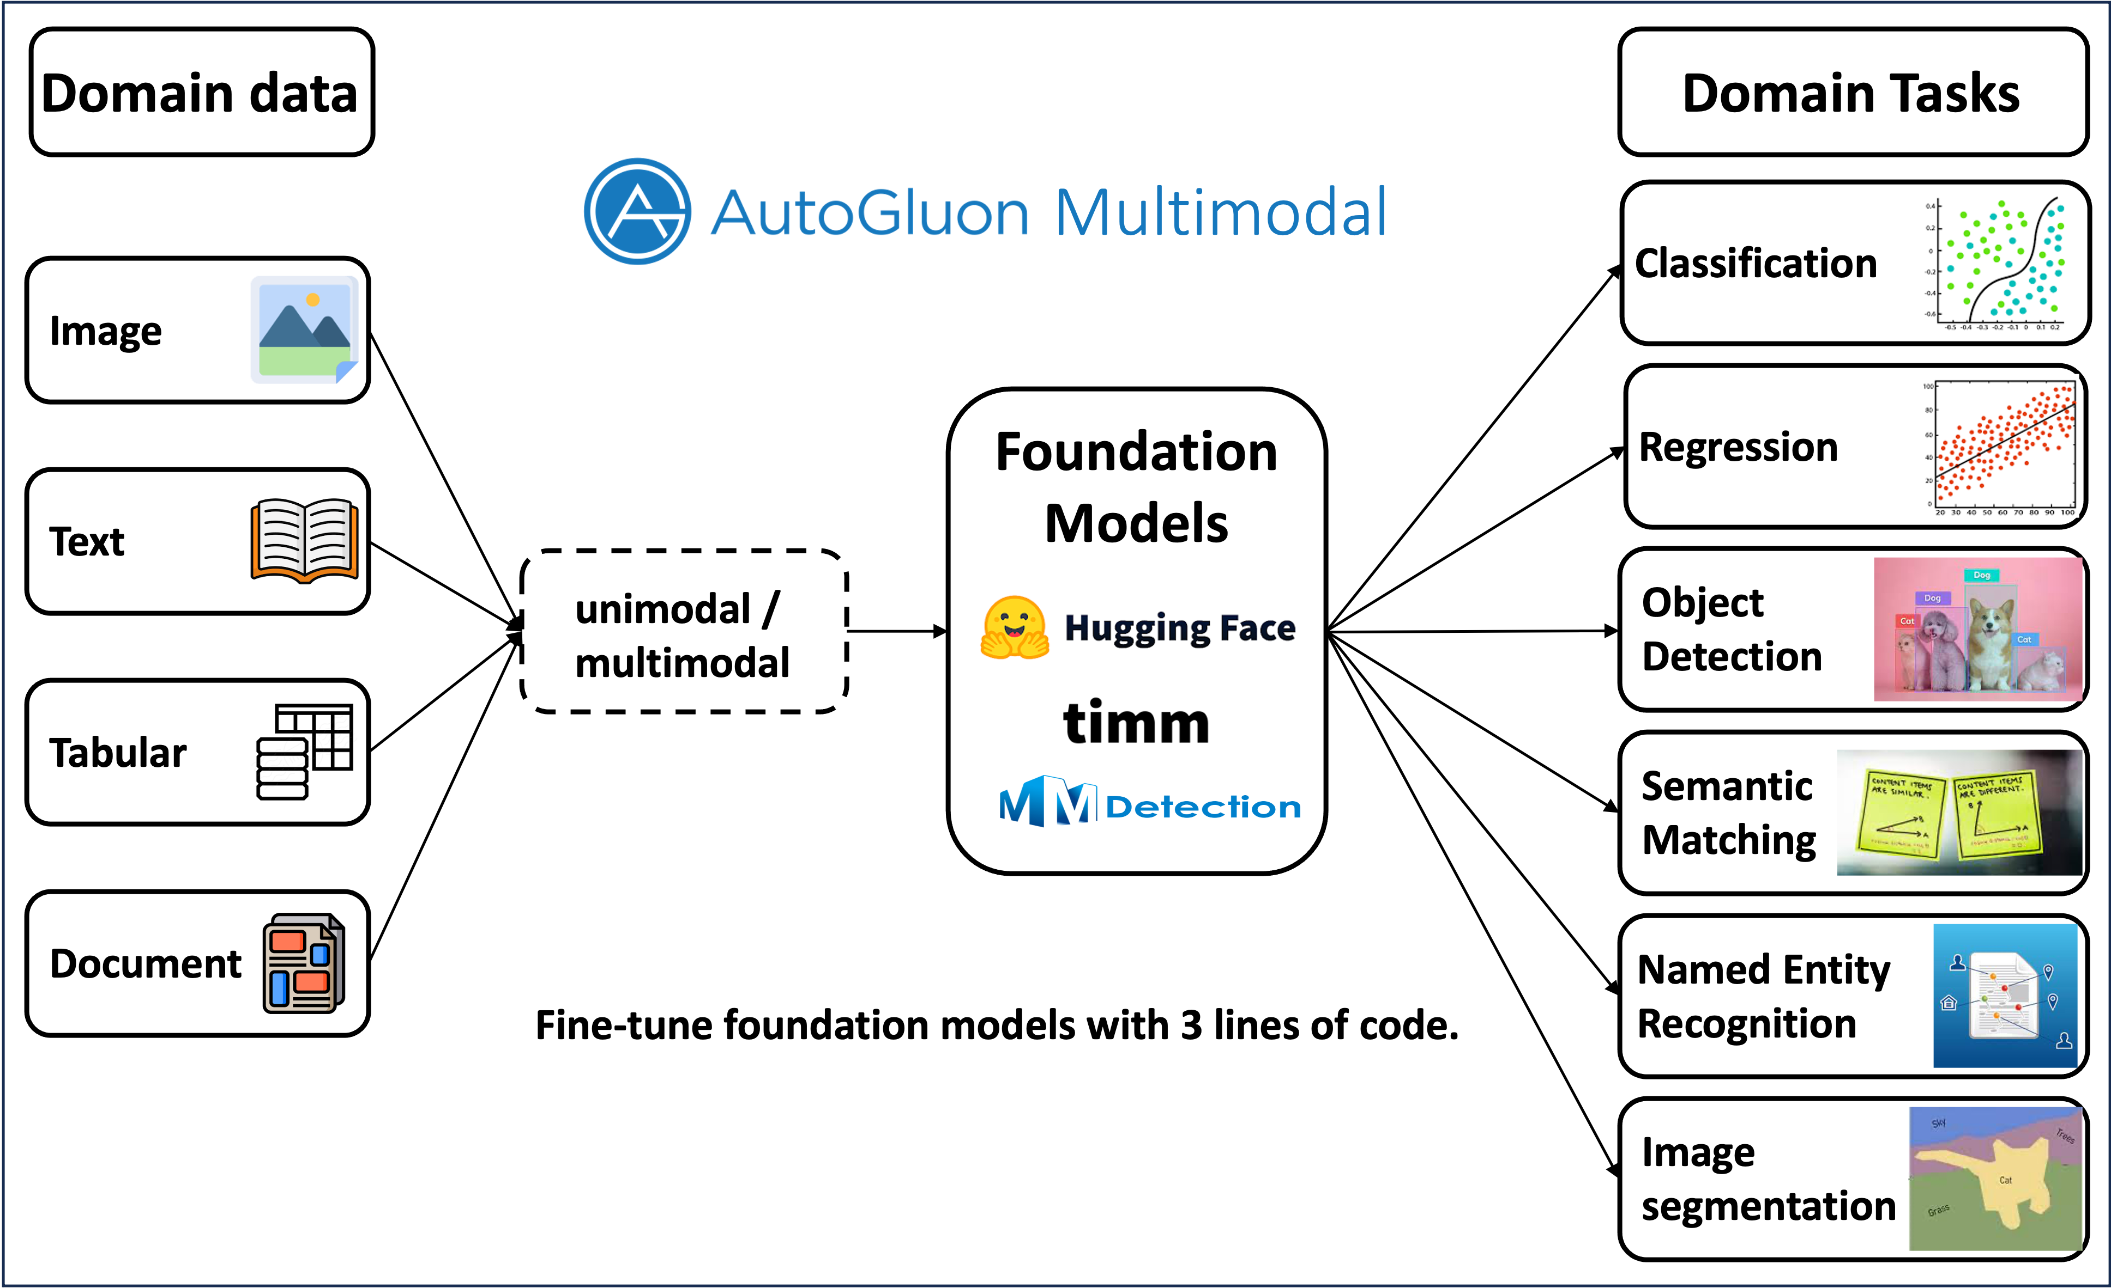
AutoGluon Multimodal Overview
Notes:
it can handle

Slide 3
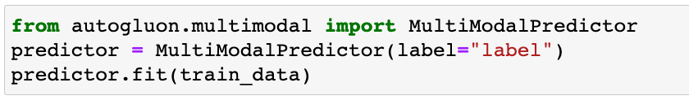
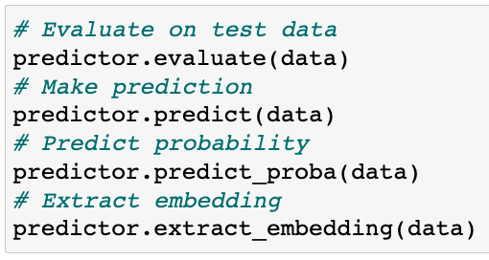
AutoGluon Multimodal Overview
Fine-tunes foundation models with 3 lines of code
Commonly used functions
Notes:
To use autogluon multimodal, all u need is ..

Slide 4
AutoML in AutoGluon Multimodal
Image
Image
Model
Detect Modalities
Text
Model
Dataframe
Text
Fusion
Output
Tabular
Tabular
Model
Automatically infer & fuse modalities
[1] Gorishniy, Yury, et al. "Revisiting deep learning models for tabular data.” NeurIPS 2021

Slide 5
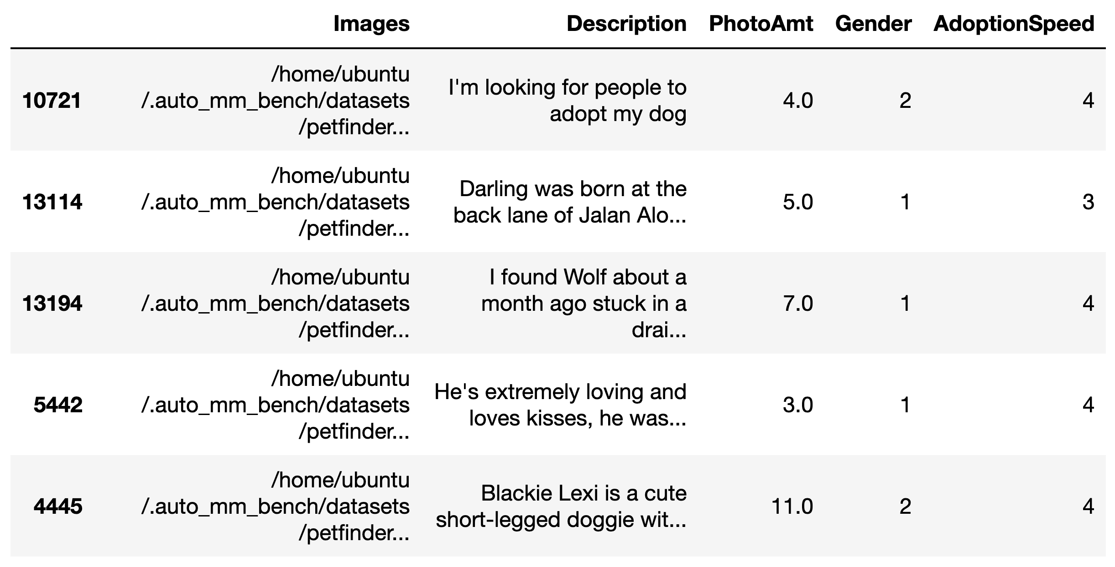
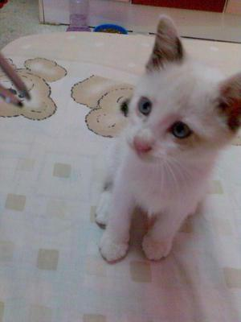
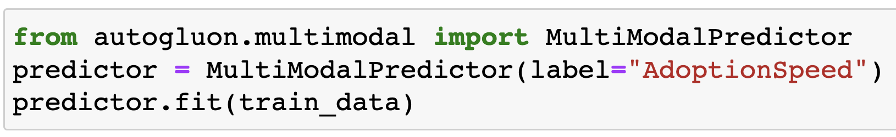
AutoML in AutoGluon Multimodal
Adoption rate: 4

Slide 6
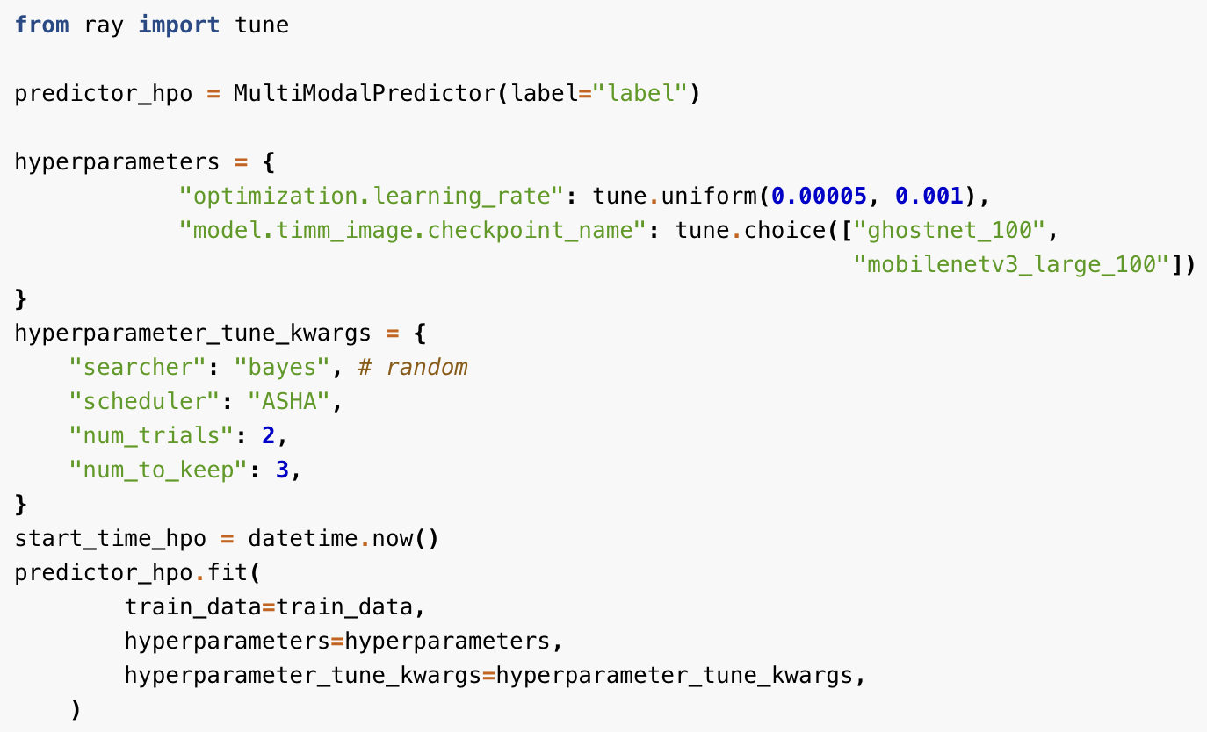
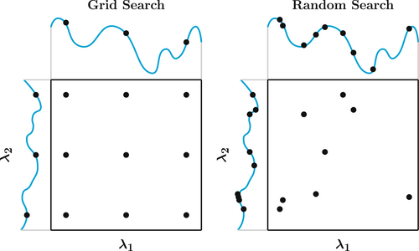

AutoML in AutoGluon Multimodal
HPO with AutoGluon Multimodal
Notes:
We use Ray Tune tune library in the backend, so we need to pass in a Tune search space or an AutoGluon search space which will be converted to Tune search space.
Defining the search space of various hyperparameter values for the training of neural networks:
Defining the search strategy for HPO with hyperparameter_tune_kwargs. You can pass in a string or initialize a ray.tune.schedulers.TrialScheduler object.
Search algorithms, how to schedule the training jobs, etc.

Slide 7
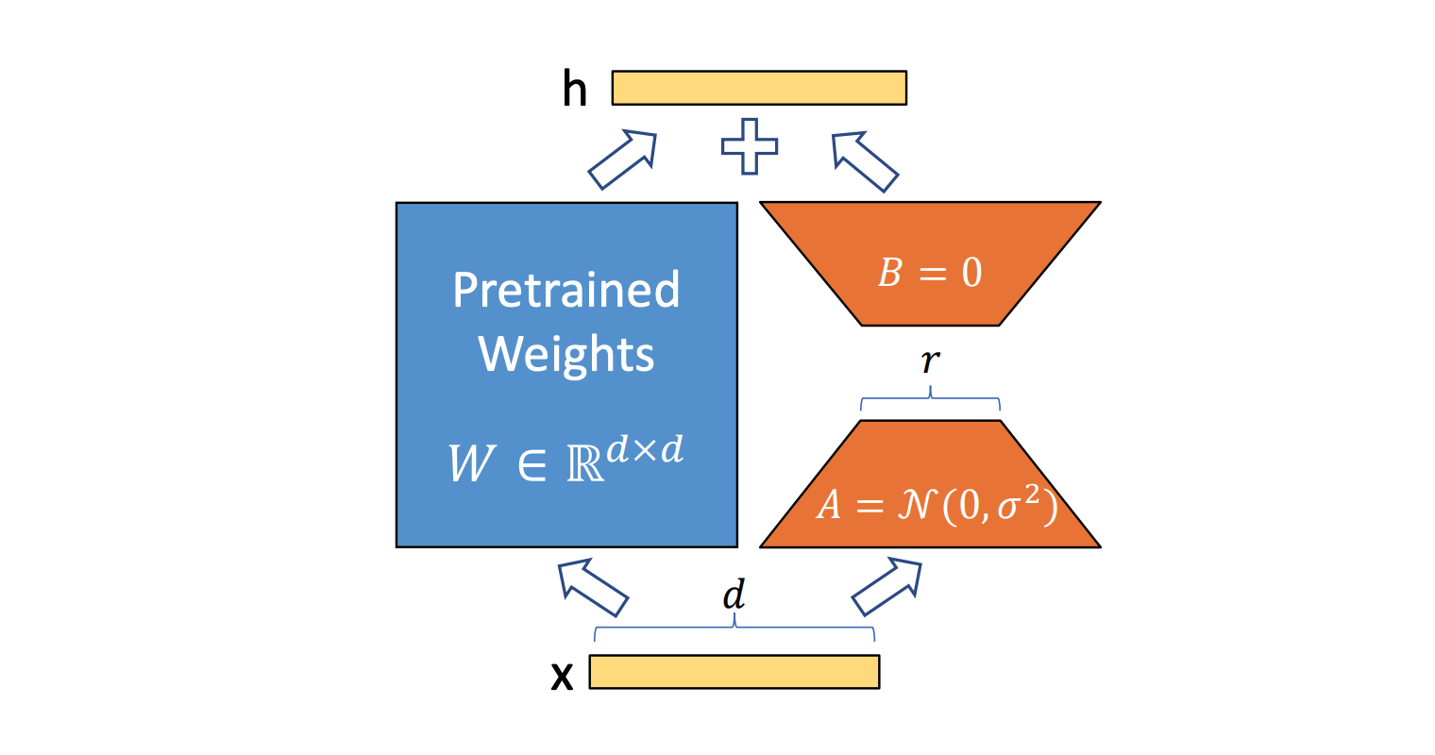
PEFT with AutoGluon Multimodal
Supported PEFT algorithms:
LORA
LORA_BIAS
LORA_NORM
IA3
IA3_LORA
CONV_LORA
Etc.
"optimization.efficient_finetune": "ia3_bias"

Slide 8
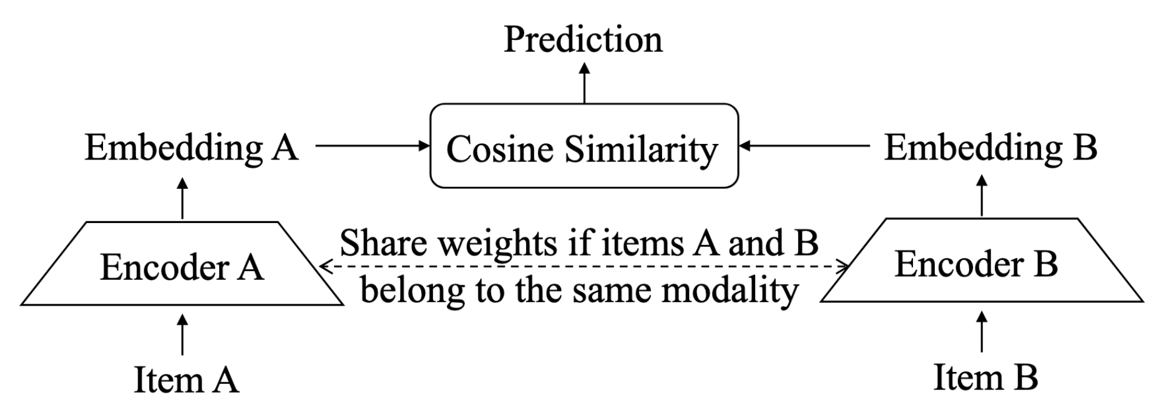
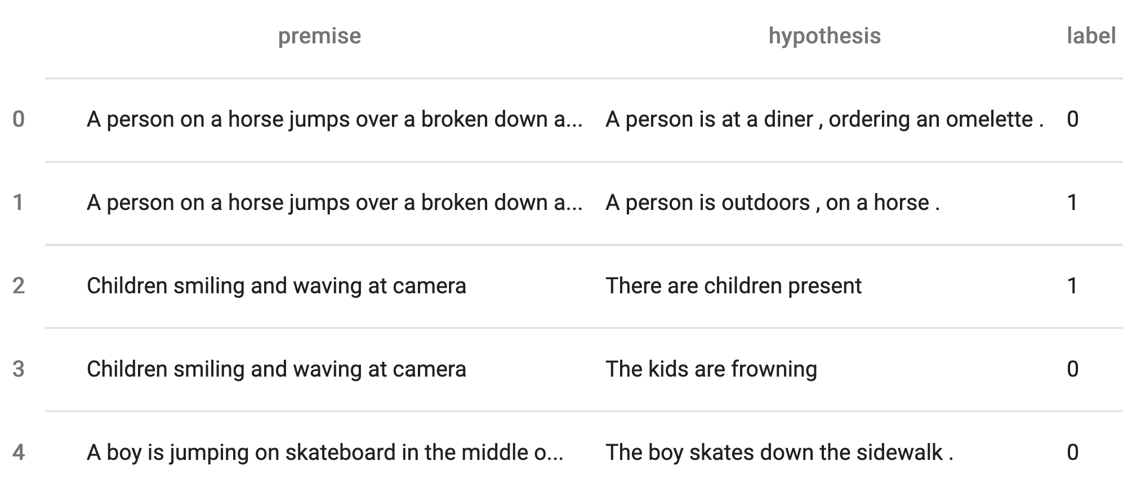
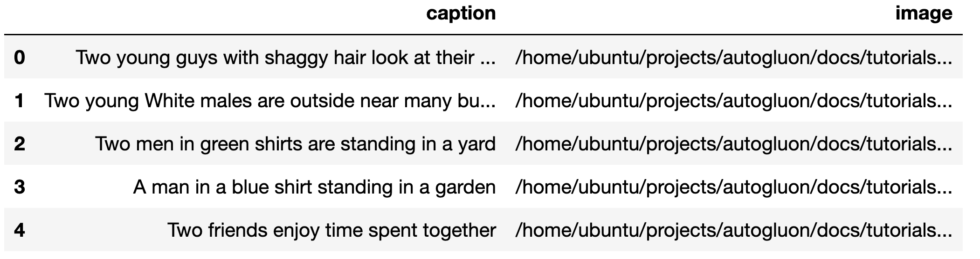
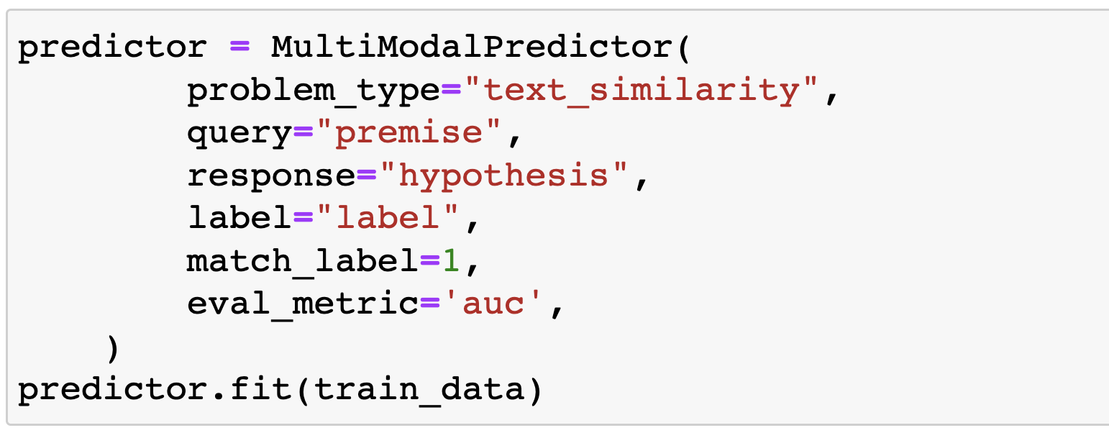
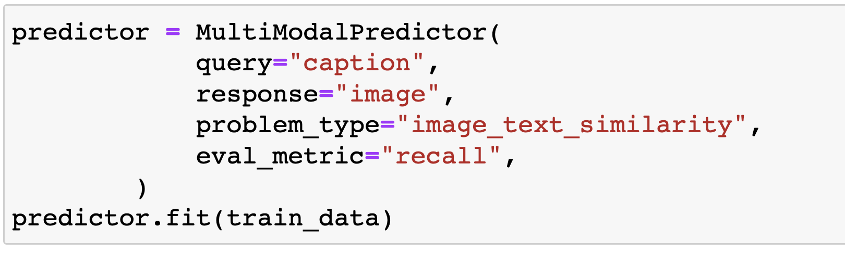
Task – Semantic Matching
Notes:
now, let's take a look at two tasks

Slide 9
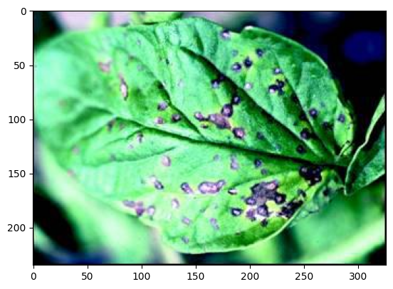
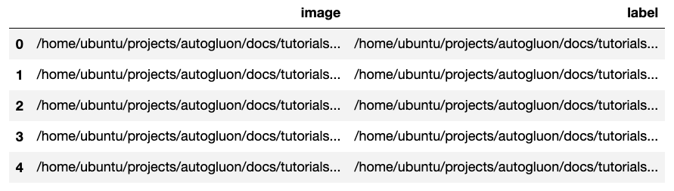
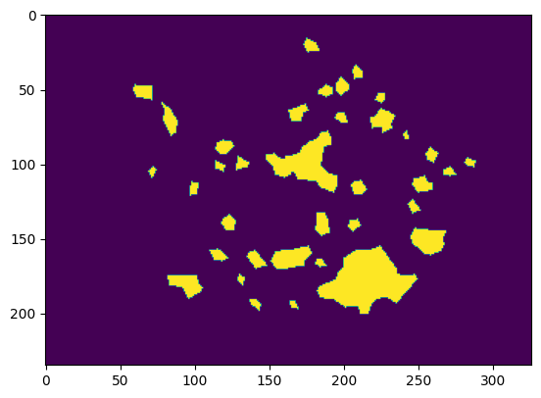
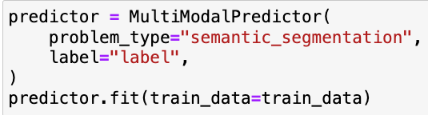
Task - Image Segmentation
Notes:
Train an Image Segmentation Model
specialized domains like remote sensing, medical imagery, agriculture

Slide 10
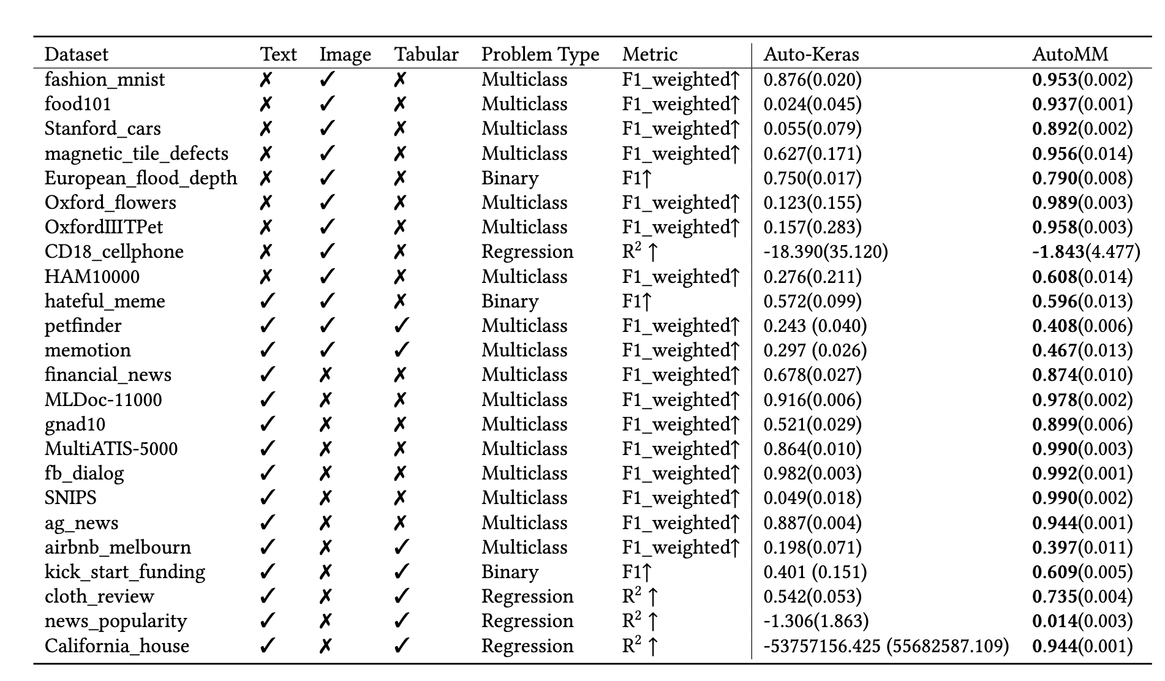
Benchmark – Classification & Regression
AutoGluon Multimodal v.s. Auto-Keras
Notes:
Last but not least, we conducted extensive benchmark experiments with over 50 datasets,

Slide 11
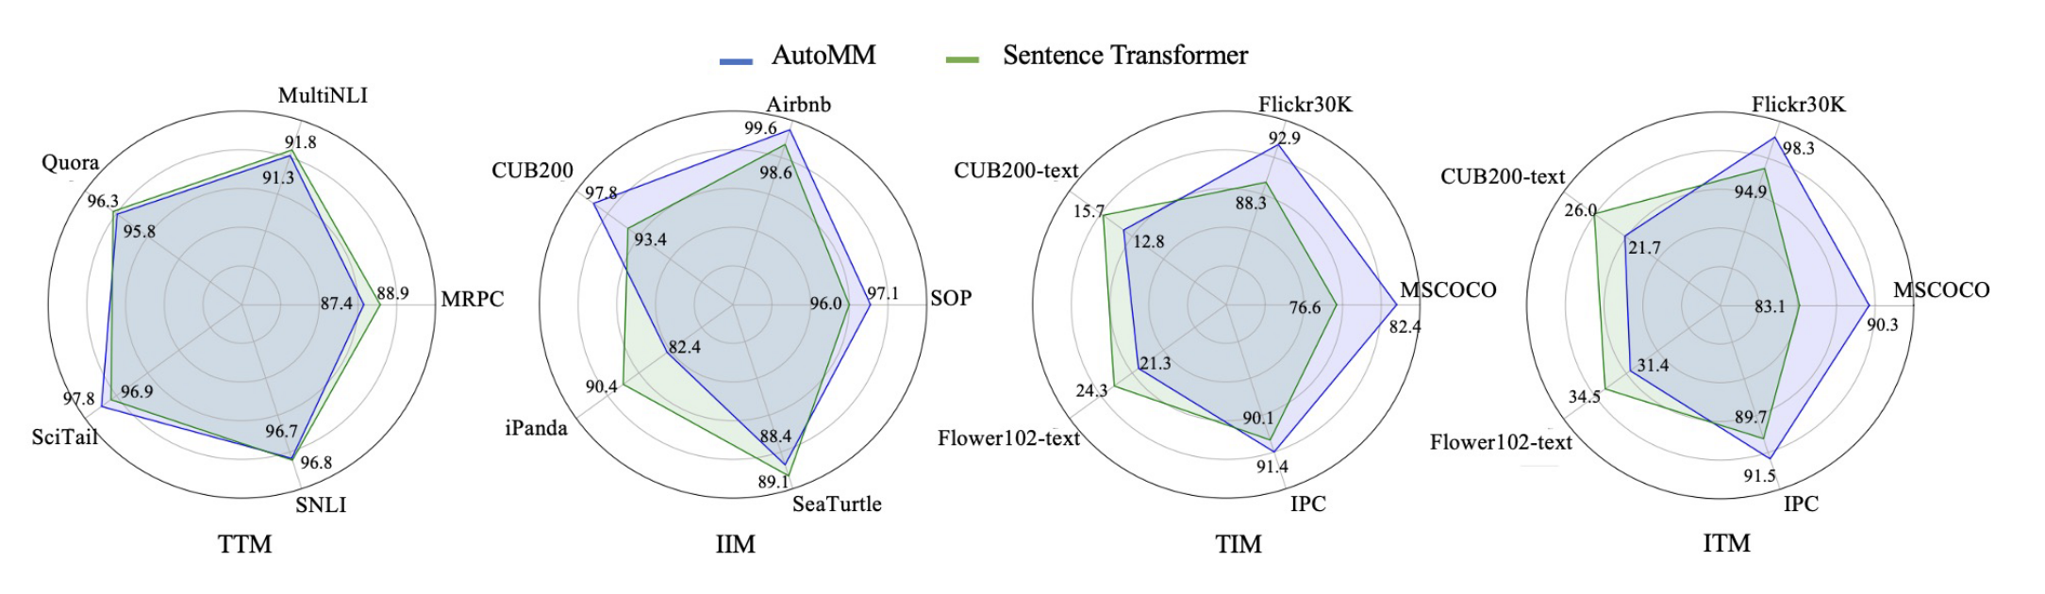
Benchmark - Semantic Matching
AutoGluon Multimodal v.s. Sentence-Transformer

Slide 12
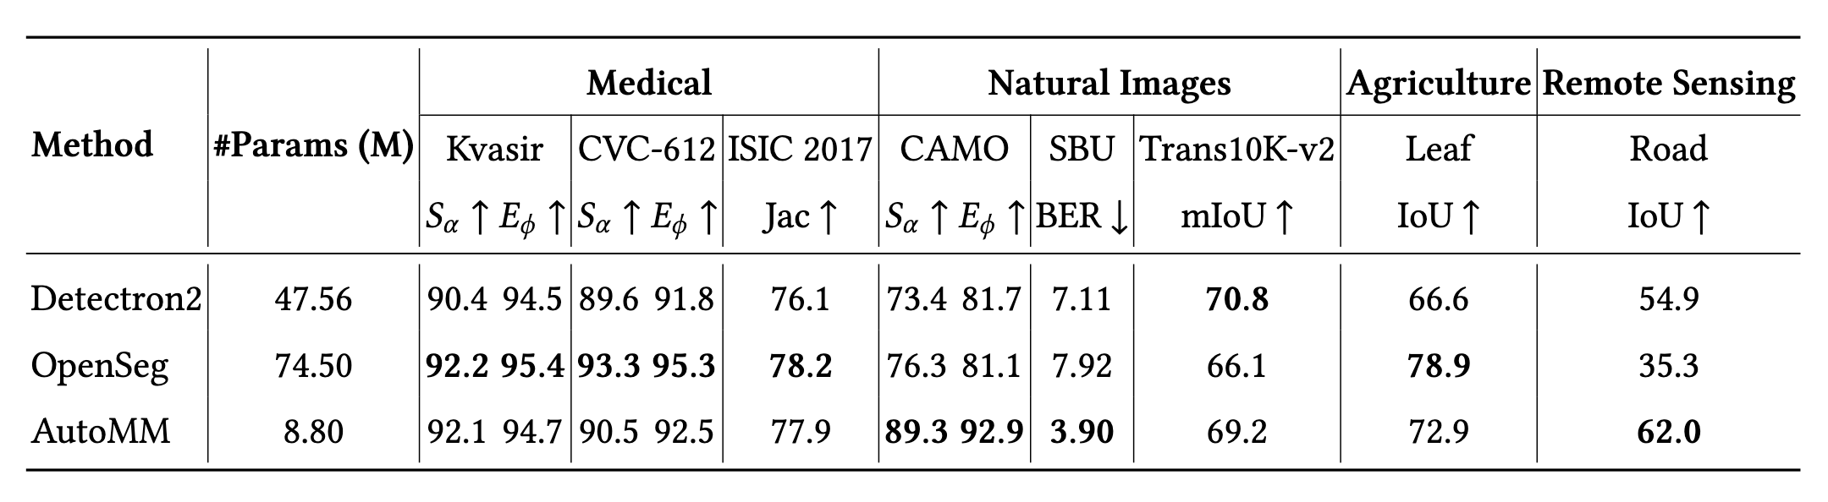
Benchmark - Image Segmentation
AutoGluon Multimodal v.s. OpenSeg & Detectron2

Slide 13

AutoGluon-RAG
Retrieval Augmented Generation with 3 lines of code!
Presenter: Dr. Shuai Zhang
Notes:
This is an open-source library that makes it easy to build a RAG, pipeline. Following AutoGluon’s philosophy, we’ve made it so that you can construct a complete RAG pipeline with just a few lines of code.

Slide 14
Why AutoGluon RAG
Simplify RAG pipeline development.
User-friendly & uniform interface.
Extensibility, configurability, and modularity.
Easy integration with different platforms.

Slide 15
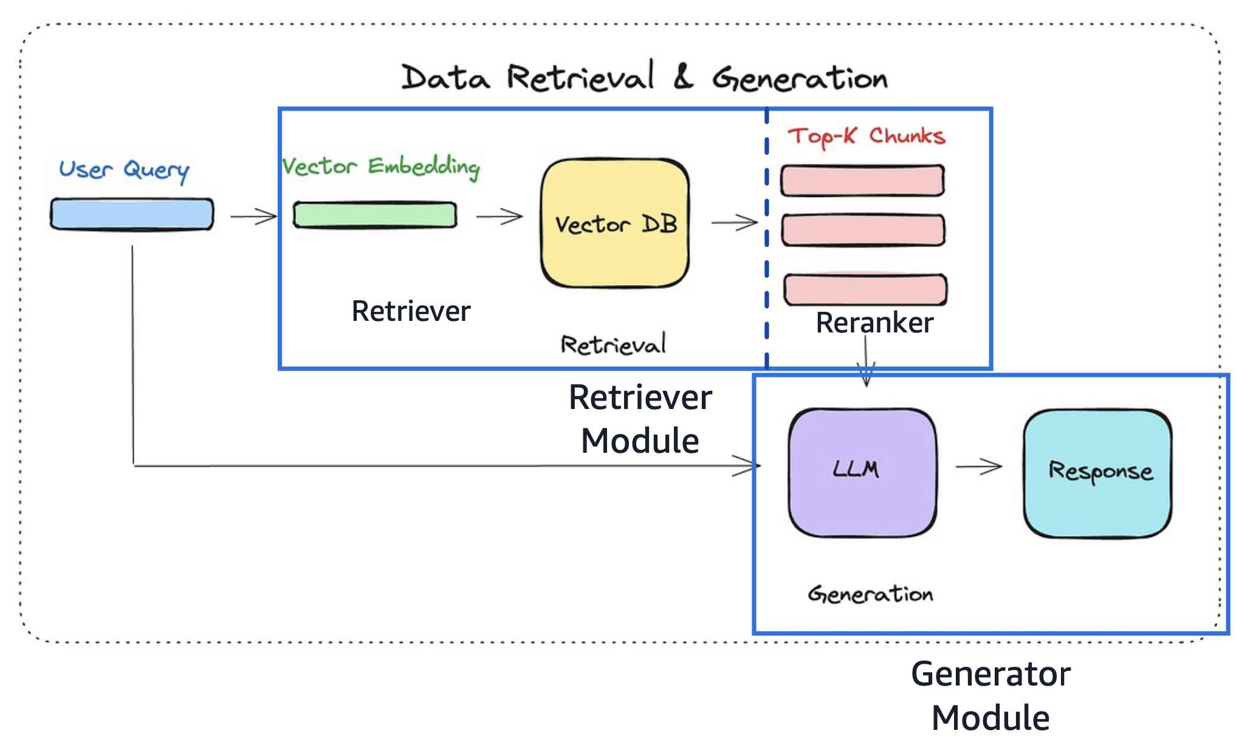
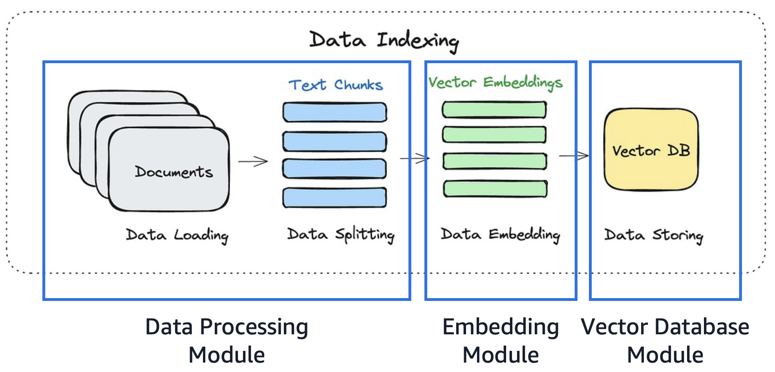
AutoGluon RAG Overview
Notes:
it takes care of all the tricky, underlying tasks for you. Things like chunking your data into smaller pieces, setting up a vector database, and running LLM inference.

Slide 16
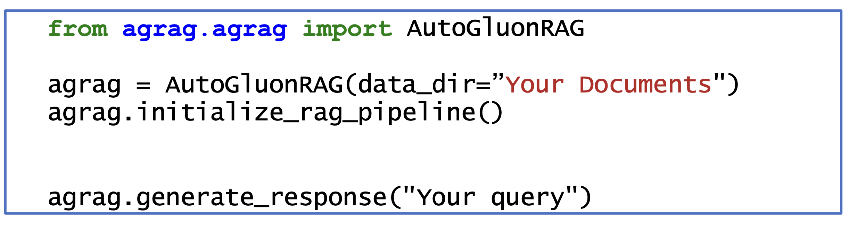
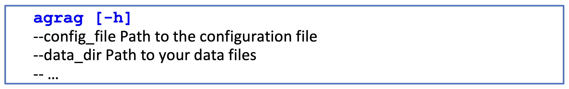
Usage of AutoGluon-RAG – Two Ways
Use AutoGluon-RAG through Code
Use AutoGluon-RAG through Command Line
Notes:
Right now, you can use it in two ways. First, through code

Slide 17

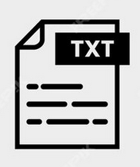

Highlighted Features
Automatic Data Type Detection
PDF
Parser
Document folder / Website URL
Detect Modalities
Text
Parser
Chunking
Doc
Parser
…
…
Notes:
https://www.freepik.com/premium-vector/document-file-format-folder-pdf-doc-xls-jpg-zip-txt-png-json-ppt-csv-xml-ai-mp3-mp4-html-psd-css-js_37500244.htm

Slide 18
Highlighted Features
Foundation Model
Bedrock
Huggingface
VectorDB
Faiss
Milvus
Data Sources
S3 Folder
Local Folder
vLLM - Fast Infer
OpenAI
Web URL
Evaluation
Exact Match
Bleu
etc
Local checkpoint
A range of fast search Index algorithms
IndexPQ
IndexHNSWFlat
IndexLSH
…
Fast inference with vLLM
PagedAttention
Speculative decoding
Quantization
…
A diverse set of evaluation metrics
AutoGluon
RAG

Slide 19
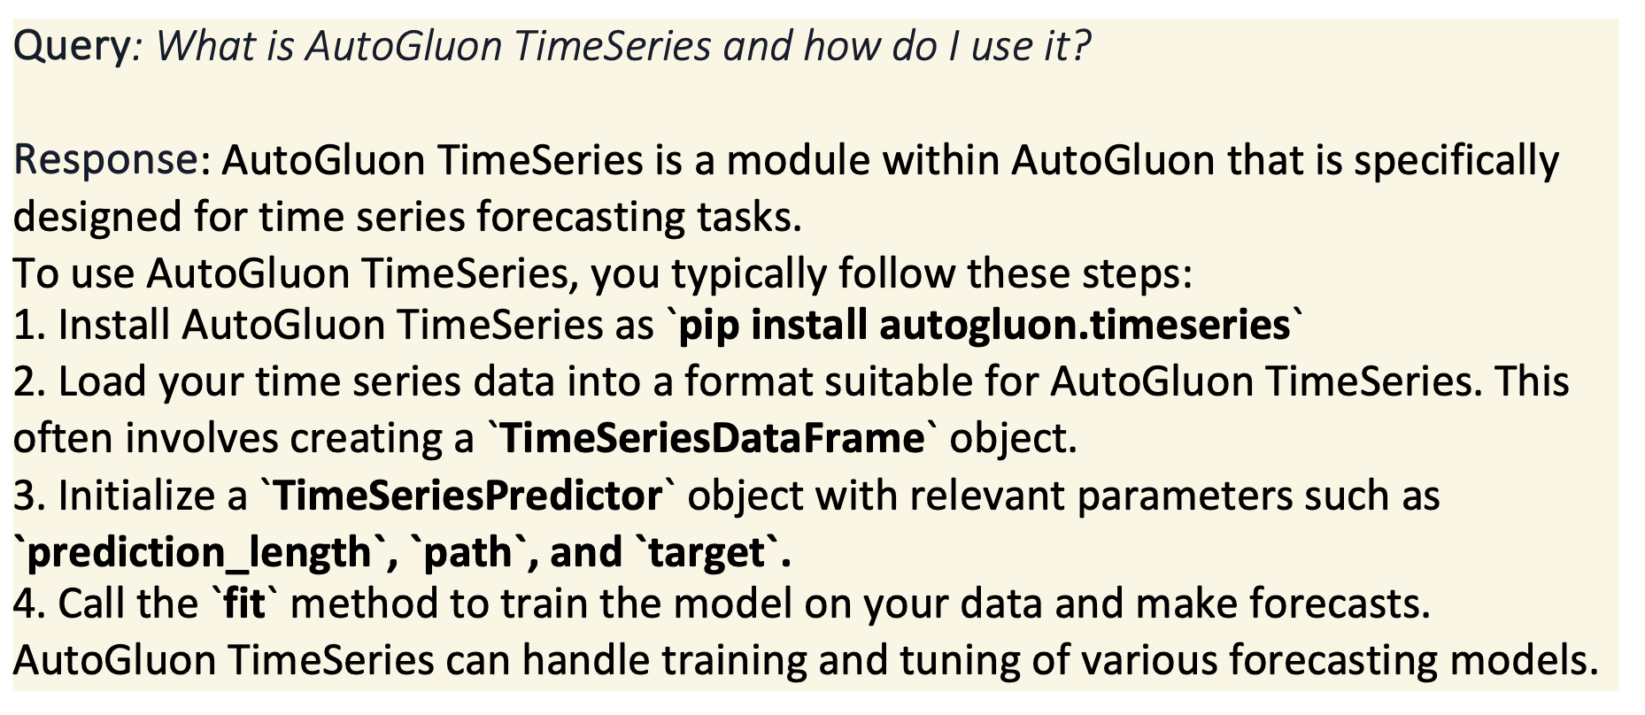
Application – Coding Assistant
Notes:
Now, let me share some examples of what you can do with AutoGluon-RAG.
One thing I built is a coding assistant. I used the AutoGluon website as input and created a tool that answers questions like, “What is AutoGluon TimeSeries, and how do I use it?” It even gives step-by-step instructions for building predictors.

Slide 20
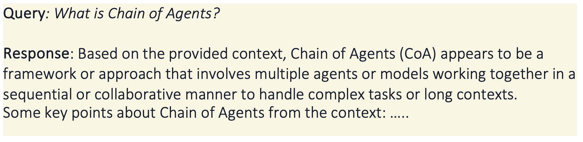
Application – Research Assistant
Notes:
Another example is with NeurIPS 2024. I built a RAG pipeline for over 4,000 accepted papers. Each document includes the title, authors, and abstract. Now, I can query the dataset to find specific methods or topics I’m interested in.

